Slide 1

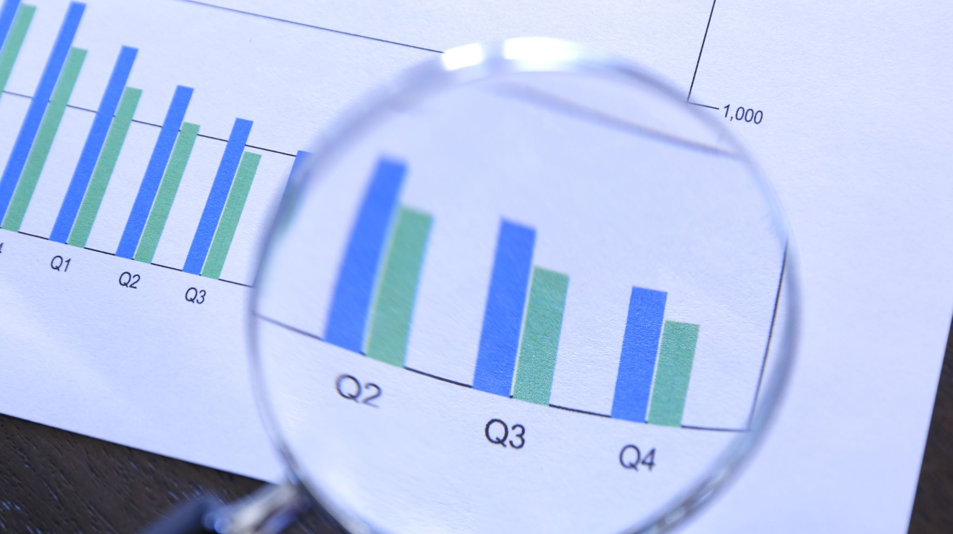
BlackRock Investment Analysis
Weekly status report 3

Slide 2
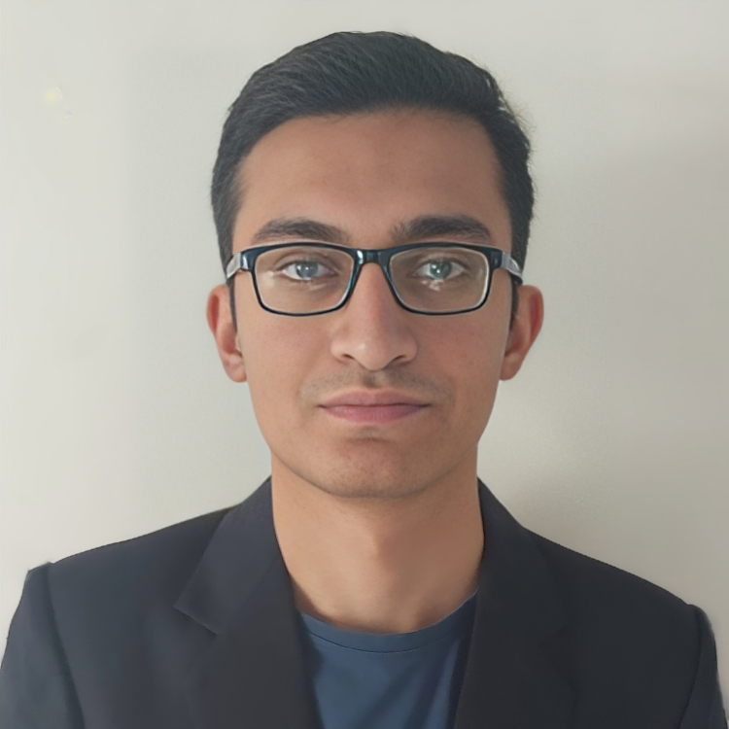
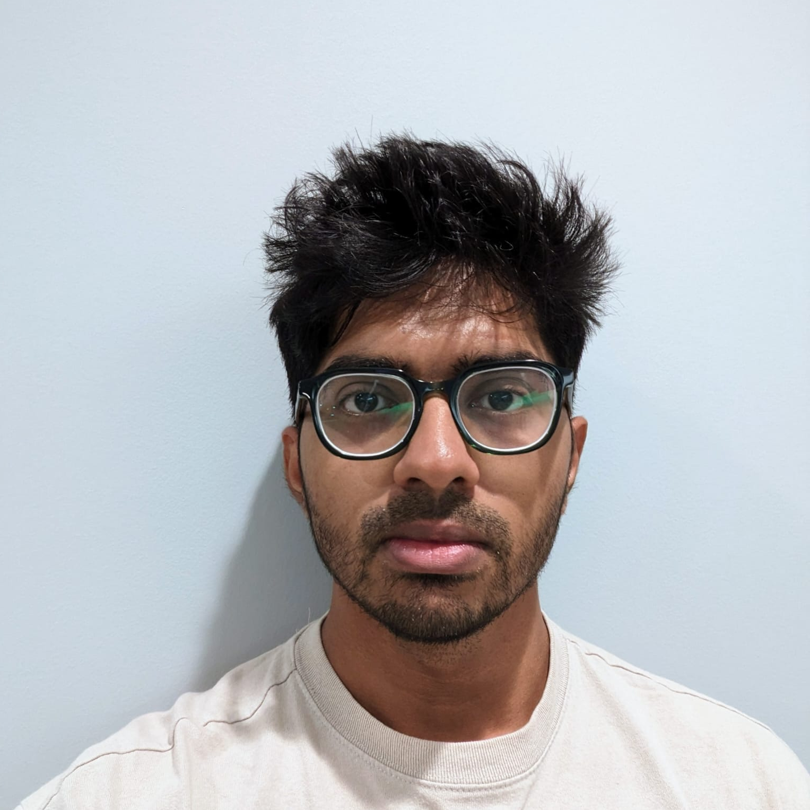
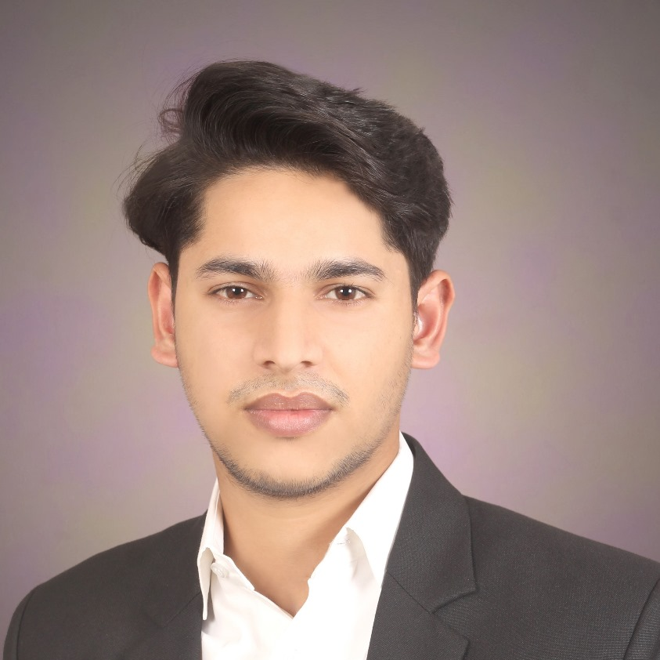
Team Members
Aryan Radadiya
Developer
Joyson Gonsalves
Team Lead
Sumit Kumar Pandey
Data Analyst

Slide 3
Date of Report: 30th January 2024
Date of Last Report: 23rd January 2024
Prepared By: Group 7
Project Status: On Track

Slide 4

Activities Since Last Report
Issues or Challenges encountered this week:
Adjusting the header of the data to align in proper format.
Combining two data in one data frame.
What was done to overcome them:
We split the data in two sections and then adjusted the headers accordingly and combined the data.
We used different code to perform operation.

Slide 5
Activities Since Last Report
Task completed this week:
Completed the cleaning process.
Share point site is fully completed.

Slide 6
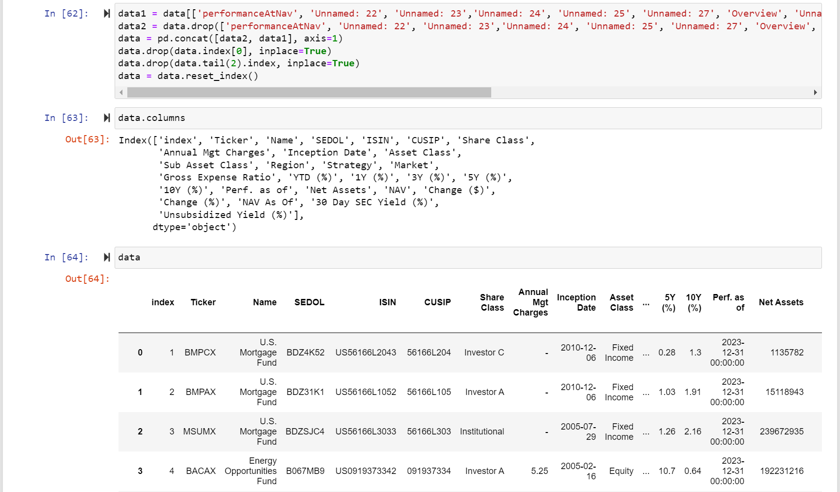
Screenshots of Activities

Slide 7
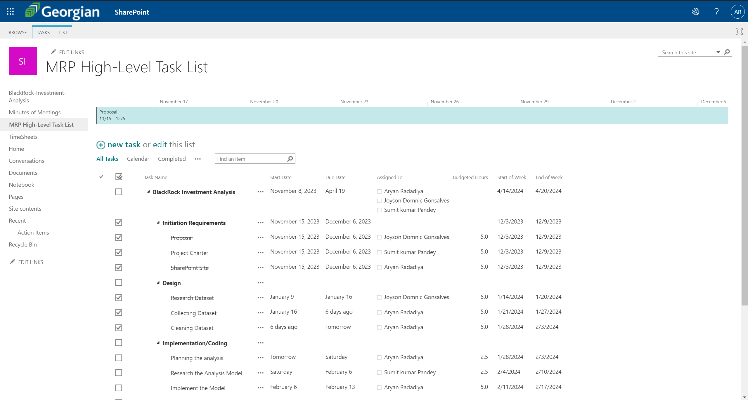
Screenshots of Activities

Slide 8
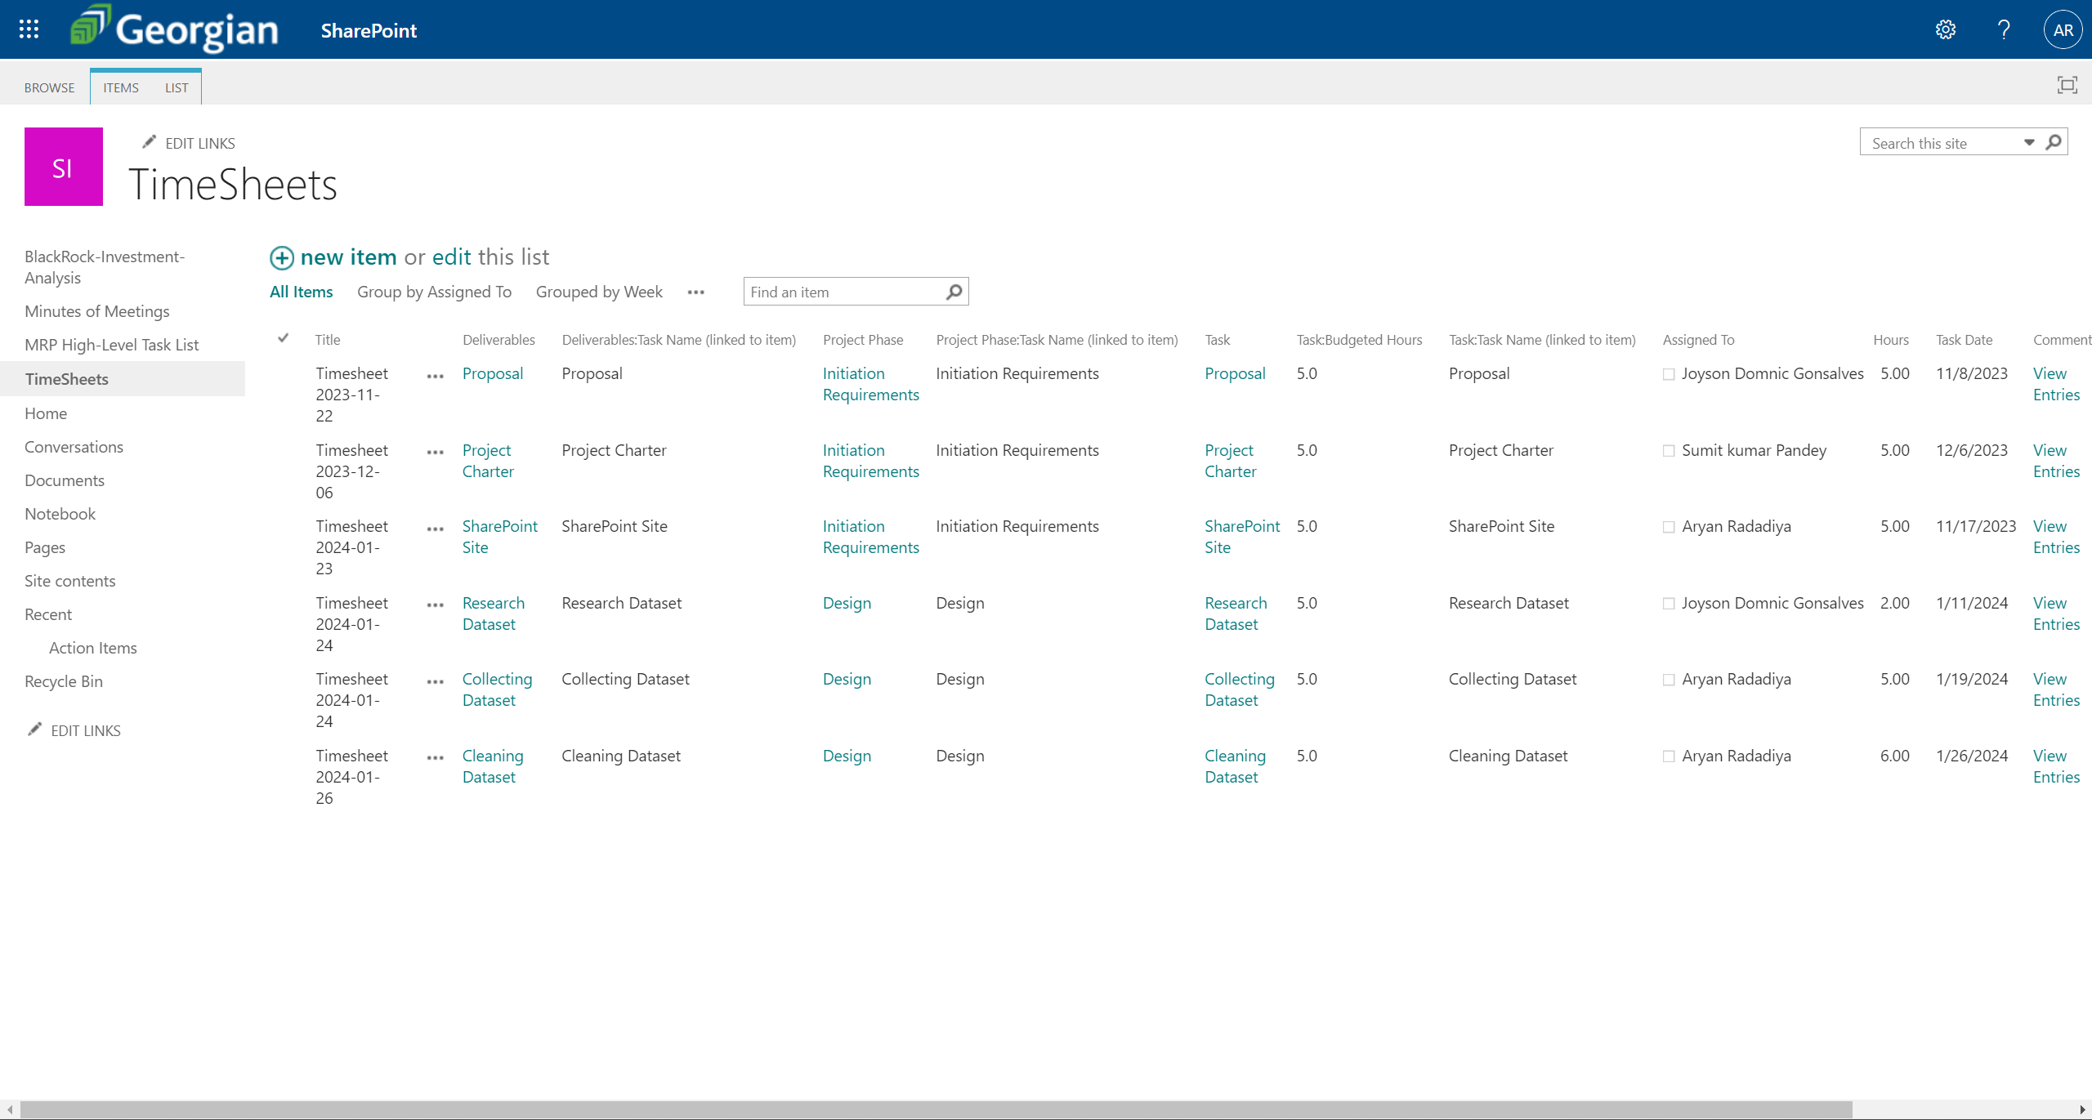
Screenshots of Activities

Slide 9
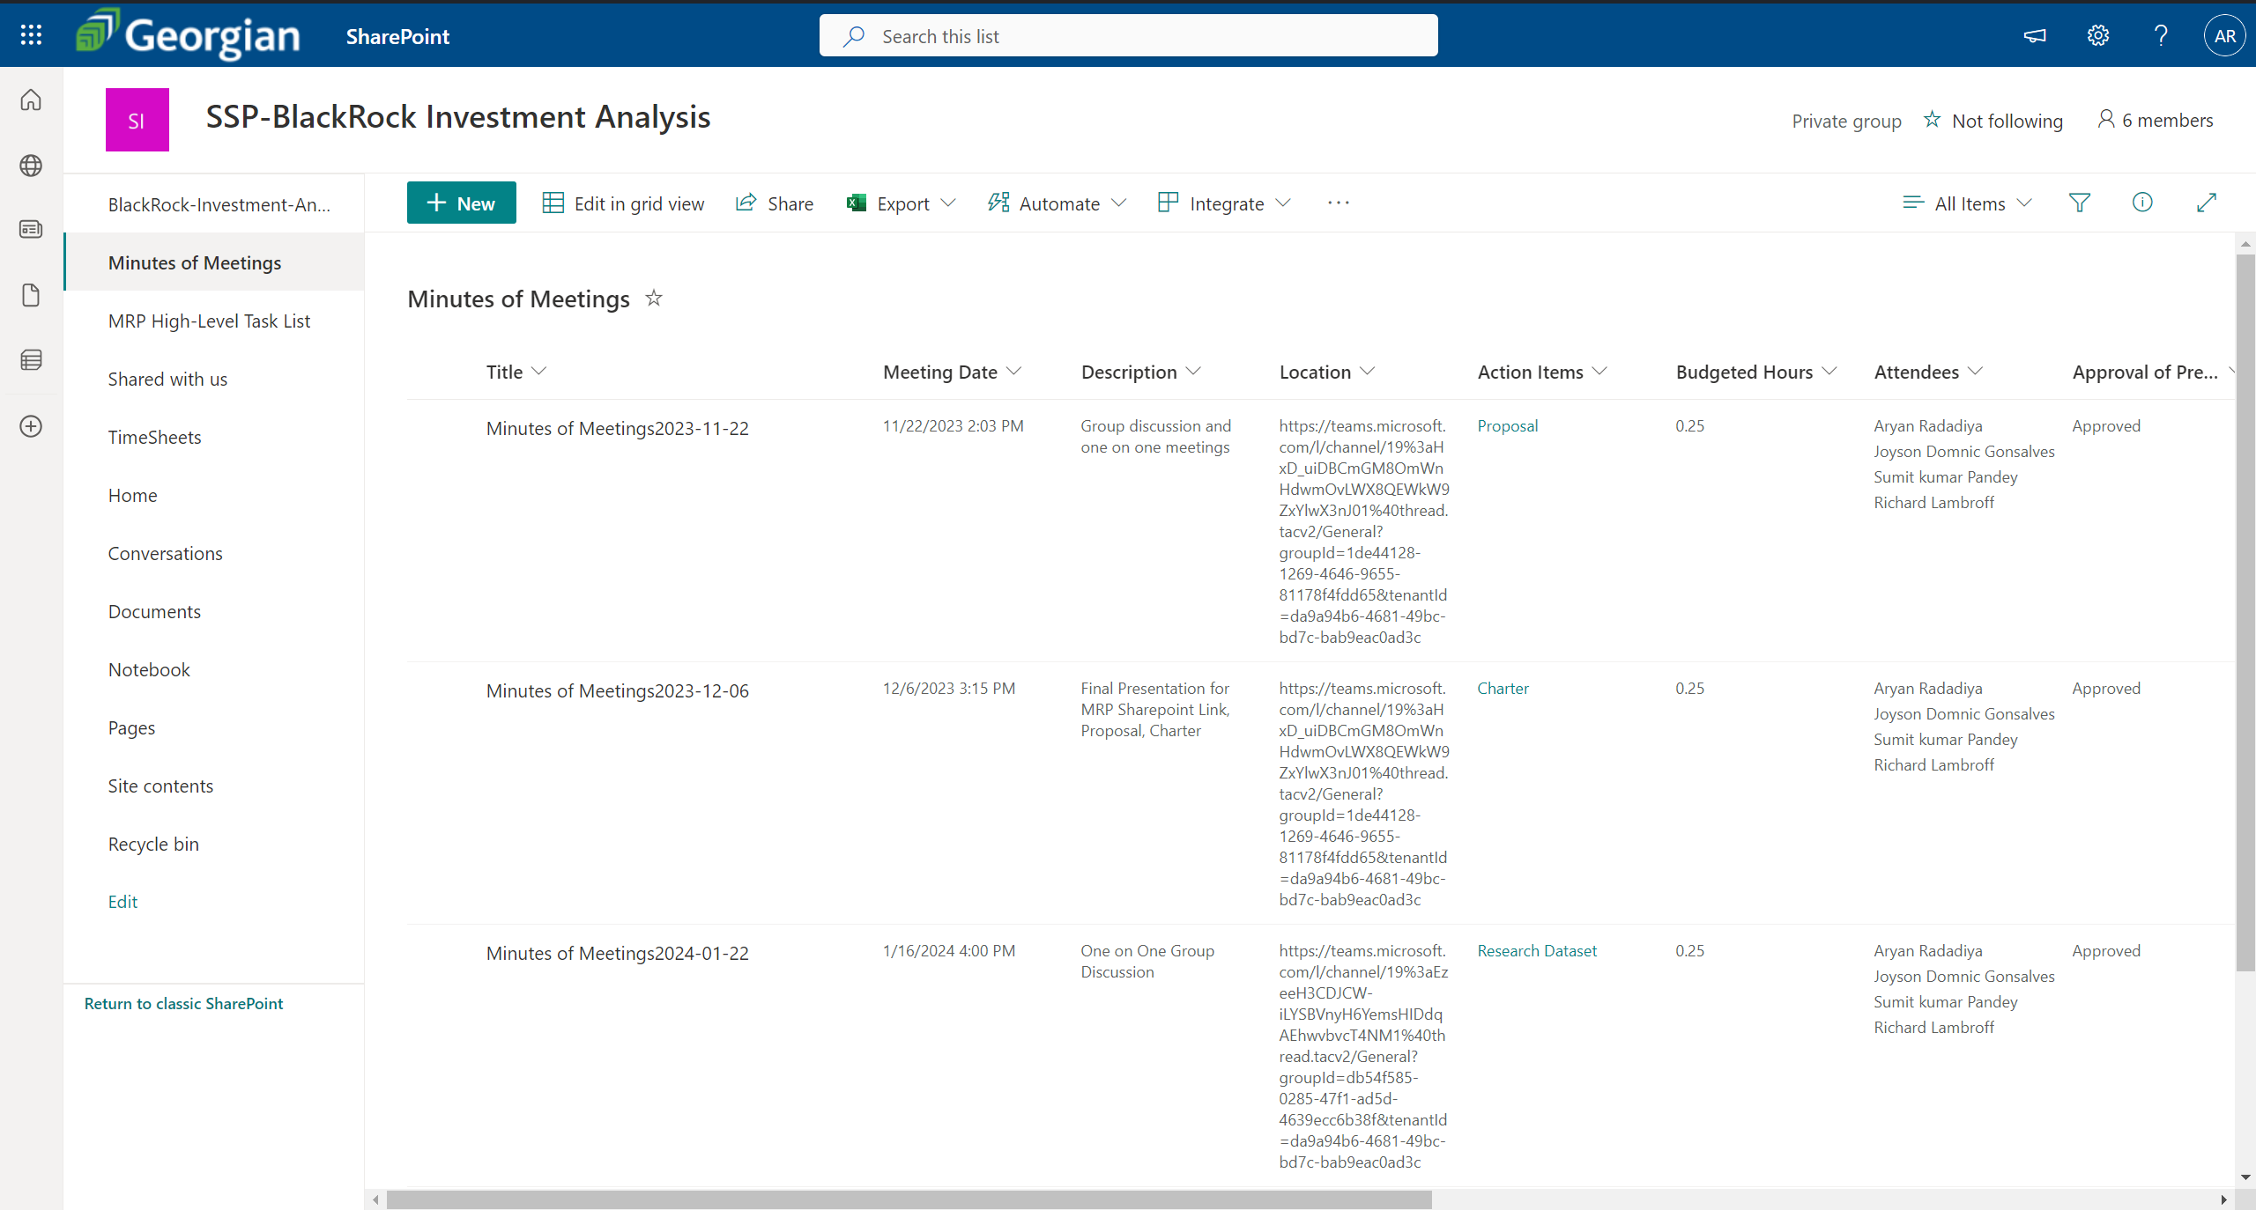
Screenshots of Activities

Slide 10
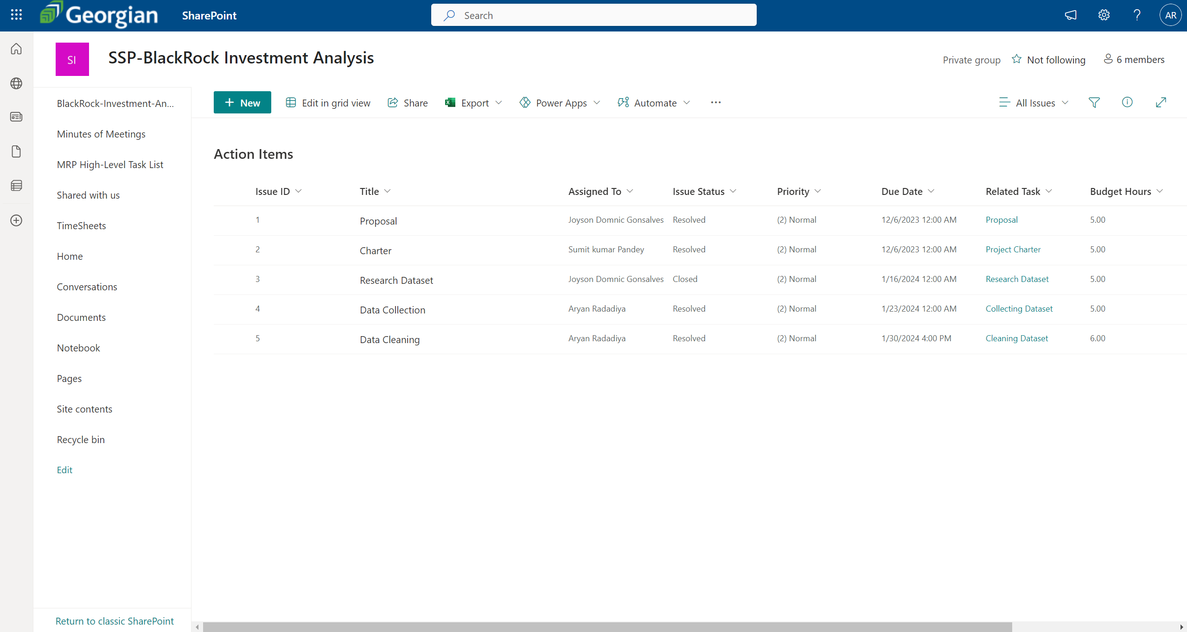
Screenshots of Activities

Slide 11



Communication
We had a phone conversation regarding the project progress and how we are going to proceed.

Slide 12

Activities to be completed before next week
Starting researching on models.
Start data processing.

Slide 13


Thank You Any Questions?

